Slide 1
IS 120
JavaScript Functions, Events, and Input

Slide 2
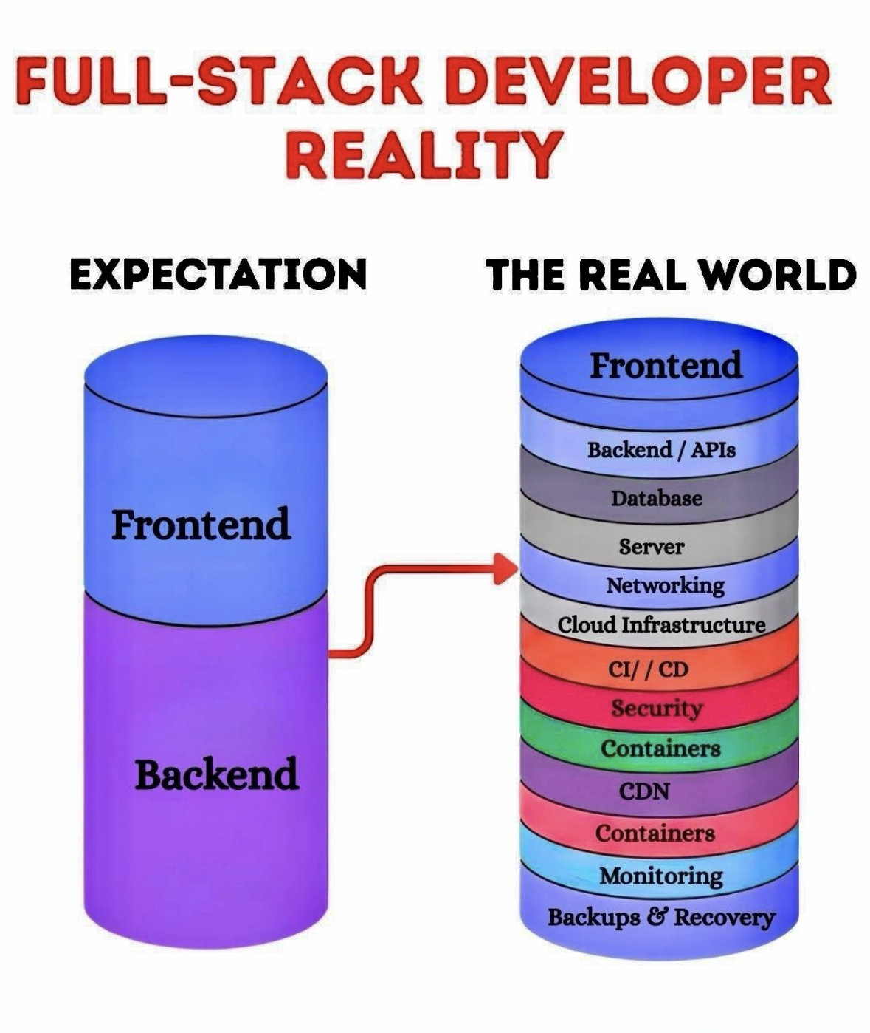

Slide 3
Review

Slide 4
querySelector()
Selects the single first element that matches a CSS selector
querySelector(“#id”)
querySelector(“.class”)
querySelector(“div”)

Slide 5
JavaScript DOM Properties
element.textContent // read
element.textContent = "Hello" // set
element.textContent += " more" // append
element.innerHTML // read
element.innerHTML = "<h1>Hey</h1>" // set
element.innerHTML += "<p>sup</p>" // append

Slide 6
JavaScript DOM Properties
element.style.color = "red"
element.style.backgroundColor = "blue"
element.style.fontSize = "2rem"
element.style.display = "block"
element.style.margin = "0 auto"
element.style.cssText = "color:red; margin:0px" // set multiple

Slide 7
JavaScript DOM Properties
element.classList
element.classList.add("active")
element.classList.remove("active")
element.classList.toggle("active")
element.classList.contains("active") // returns true/false
element.classList.replace("old", "new") // swap

Slide 8
JavaScript DOM Properties
img.src = "dog.png"
a.href = "https://example.com"
element.id = "main-title"
element.className = "card" // replaces existing classes

Slide 9
JavaScript DOM Element Creation
You can create new HTML elements using the DOM
createElement(“div”) -> creates a new element
appendChild() -> choose where the new element goes
remove() -> deletes element

Slide 10
JavaScript Functions
Why functions?
  Reusability and organization
  Execute code based on DOM events
// this is a function
function doSomething(){}

Slide 11
JavaScript Functions
Function Parameters
function add(num1, num2){
return num1 + num2;
}
Function Arguments
add(1, 2);

Slide 12
JavaScript Functions
Functions can have a return value, but don’t have to
function add(num1, num2){
return num1 + num2;
}
function add(num1, num2){
console.log(num1 + num2);
}

Slide 13
JavaScript Functions
Variables are only available within the block or function where they were defined
function add(num1, num2){
const result = num1 + num2;
}
console.log(result) // error

Slide 14
JavaScript Functions
Variables are only available within the block or function where they were defined
const result;
function add(num1, num2){
result = num1 + num2;
}
console.log(result)

Slide 15
JavaScript Events
An event is something that happens in the browser, often caused by the user
99% of the time, this is going to be a “click” event
element.addEventListener("click", functionName);

Slide 16
JavaScript Events
You might see uses like this
<button onclick="myFunction()">Click me</button>
addEventListener() is industry standard
JavaScript and HTML should be isolated from one another
When you’re hunting for bugs, it’s easier to do it in a single JS file than trying to find every single button in your HTML

Slide 17
JavaScript Click Event Demo

Slide 18
HTML Input
New HTML tag!
<input type="type">
Lots of different input types
https://www.w3schools.com/html/html_form_input_types.asp
All the ones you really need are text, number, radio, checkbox

Slide 19
HTML Input
<label for="textInput">Text Input</label>
<input type="text" id="textInput">
label for attribute needs to match the input id
This helps screen readers understand what the input is for
The label also increases the clickable area for input
Demo

Slide 20
HTML Input
Radio and checkbox inputs need an additional attributes
The name attribute needs to match to signal that they are part of the same group
The value attribute determines what the value is of the selected input

Slide 21
HTML Input
Input.value will always return a string
If you want it to be a number, you will need to turn that string into a number format
parseInt() -> converts string to a whole number
parseFloat() -> converts string into a number with decimals

